Slide 1
British Airways Flight Reviews
Abdul Rasheed

Slide 2
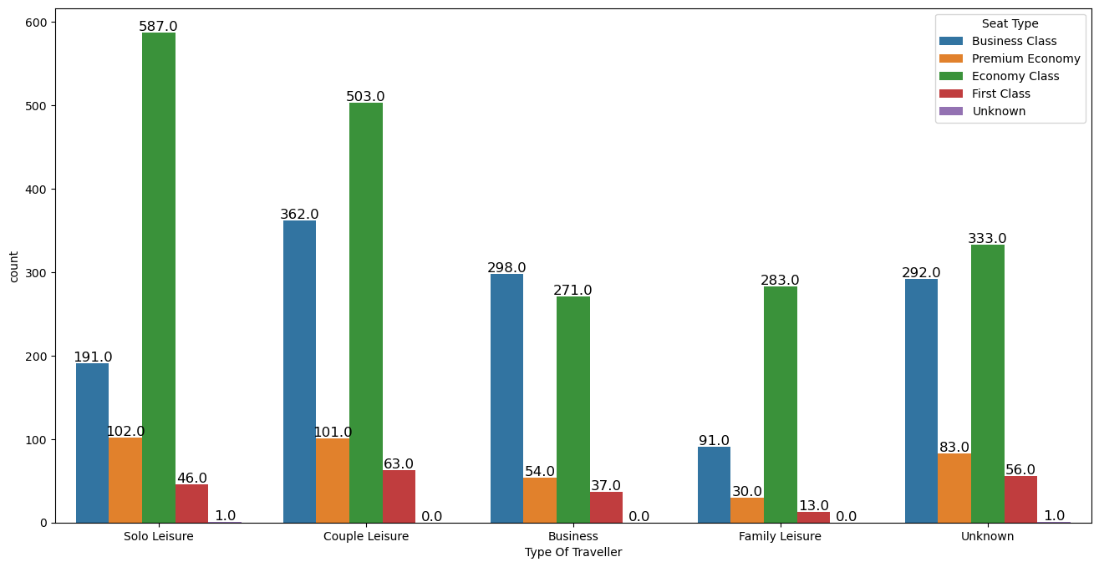
Distribution of different traveler types across various seat types:
In every type of traveler most customer book the Economy seat which is 1977 in total, second the business class with 1234, together 3211 which account for 84.54% of all the seats.

Slide 3
Average Total Ratings for Different Types of Travelers:
Type Of Traveller | Seat Comfort | Cabin Staff Service | Food & Beverages | Ground Service | Value For Money | Inflight Entertainment | Total Rating
Business | 2.507576 | 2.865152 | 2.345455 | 2.486364 | 2.121212 | 2.569697 | 1.756061
Couple Leisure | 2.773567 | 3.194363 | 2.686103 | 2.823129 | 2.551992 | 2.839650 | 2.251215
Family Leisure | 2.772182 | 3.167866 | 2.669065 | 2.717026 | 2.513189 | 2.781775 | 2.142686
Solo Leisure | 2.996764 | 3.331176 | 2.843581 | 2.970874 | 2.796117 | 2.894283 | 2.489213
Unknown | 3.210458 | 3.532026 | 3.075817 | 2.996078 | 3.266667 | 2.958170 | 2.6169932.
Note : Unknown is the missing data

Slide 4
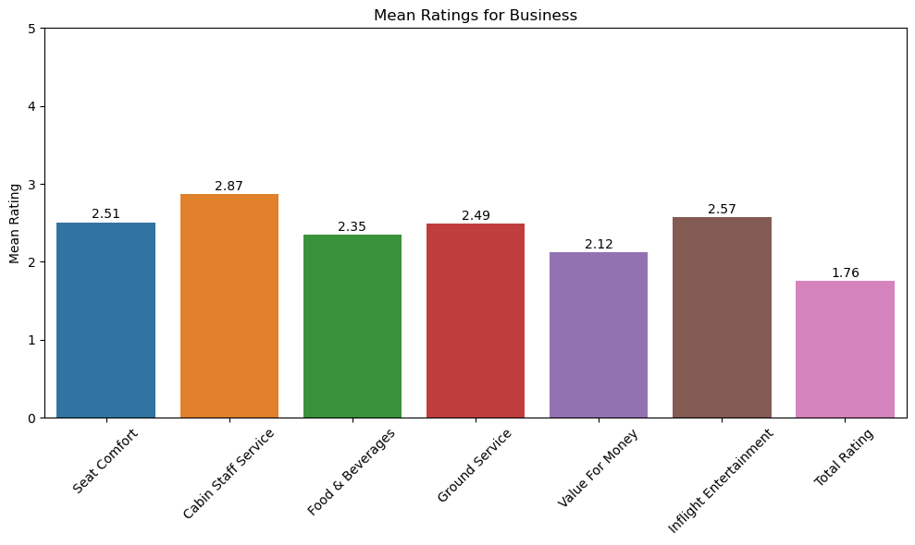
Average Ratings of Business Travellers:
The average ratings of Business travelers is the lowest among all types of travelers, significant difference in total ratings which is 1.76 on scale of 5.

Slide 5
Percentage of Business travellers recommending British Airways:
The total number of Business travelers passengers are 660.
77.42% of business travelers are not recommending the British Airways.
Only 22.42% are recommending to fly with British Airways.

Slide 6
Average Ratings of different types of classes:
Seat Types | Seat Comfort | Cabin Staff Service | Food & Beverages | Value For Money | Inflight Entertainment | Total Rating
Business Class | 2.901945 | 3.438412 | 2.949757 | 2.760940 | 2.782010 | 2.552674
Economy Class | 2.734952 | 3.057663 | 2.567021 | 2.586748 | 2.692463 | 2.150228
First Class | 3.665116 | 3.920930 | 3.218605 | 3.051163 | 3.074419 | 2.993023
Premium Economy | 3.029730 | 3.113514 | 2.710811 | 2.664865 | 2.813514 | 2.412162
Unknown | 1.000000 | 3.000000 | 2.000000 | 1.000000 | 2.500000 | 1.250000

Slide 7
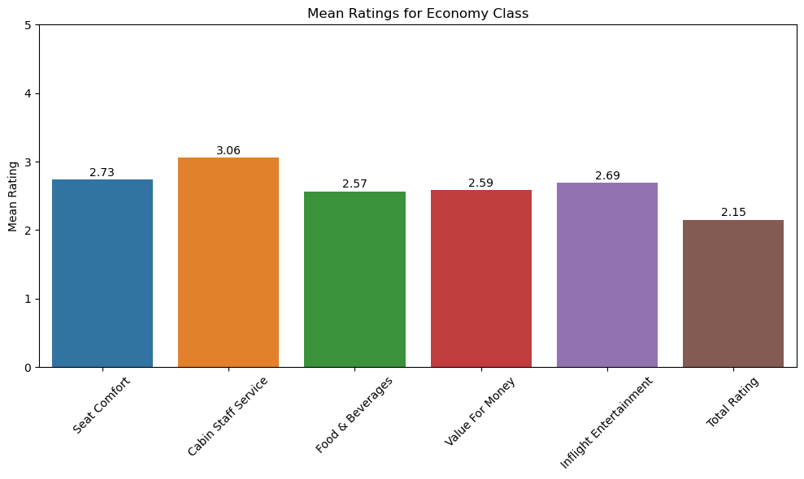
Average Ratings of Economy Seat:
Economy Class has the lowest of all Ratings, with total rating 2.15

Slide 8
Percentage of Economy class recommending British Airways:
The total number of Economy seats passengers are 1977.
64.18% of Economy passengers are not recommending the British Airways.
Only 35.81% are recommending to fly with British Airways.

Slide 9
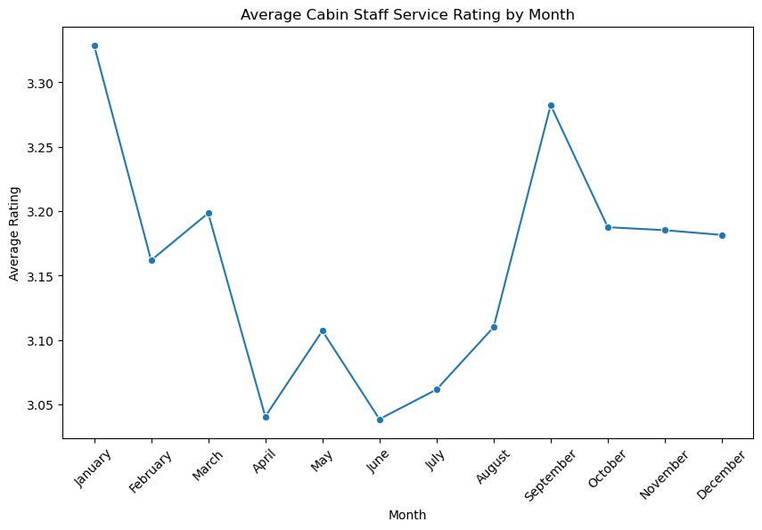
Cabin Staff Service Ratings by Months:
The average cabin staff is lowest between the months of April to August.

Slide 10
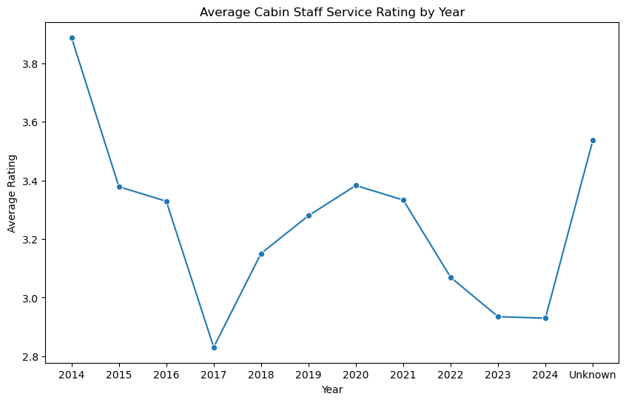
Cabin Staff Service Ratings by Years:
The average cabin staff services was the lowest in 2017. In the following few years It was improved and declining since 2020.

Slide 11
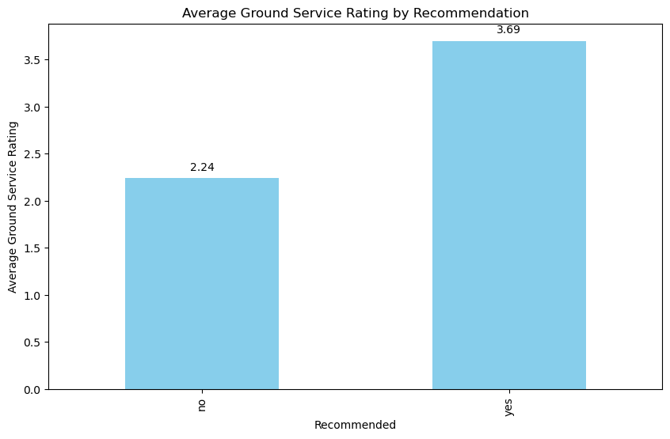
Ground Services impact the Recommending the British Airways;
The average Ground service for passenger not recommended British airways is 2.24, whereas those recommending is 3.69. Hence, the ground services plays an important factor for customers to recommending the British Airways.

Slide 12
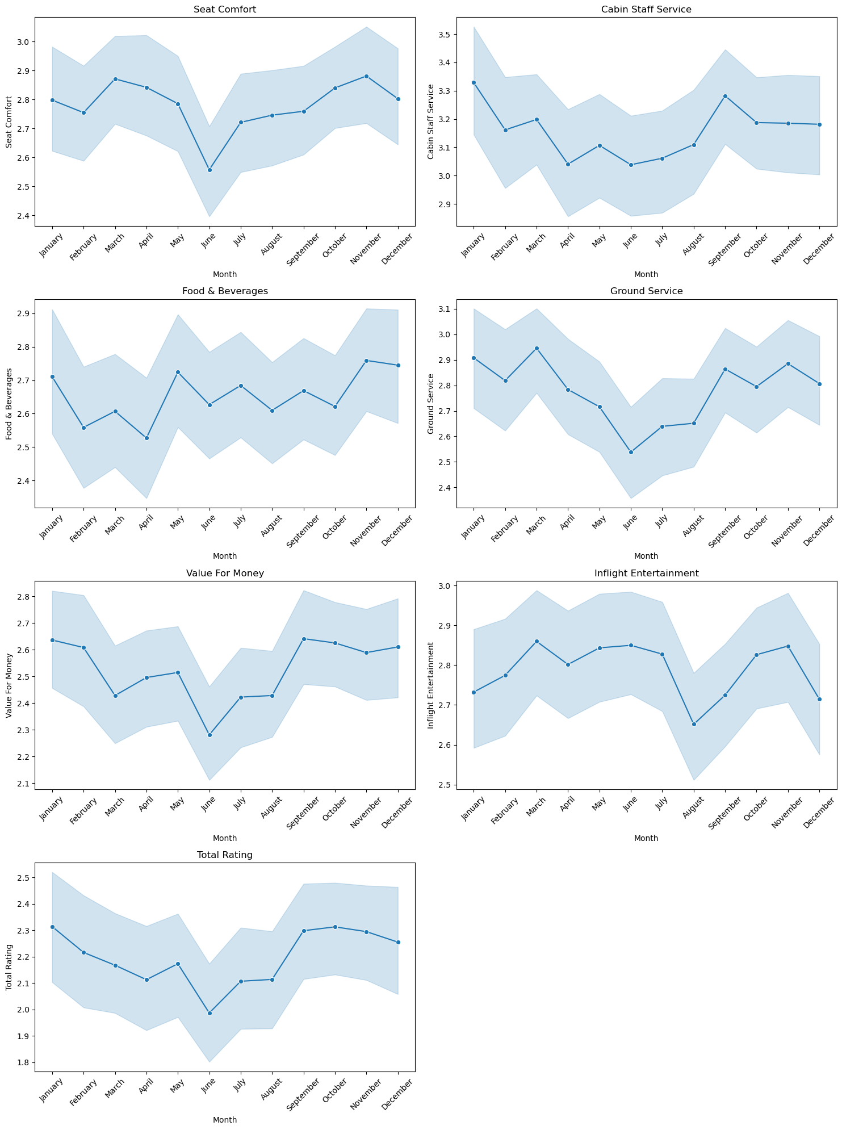
Different ratings across different months:
All the ratings are the lowest in the middle of years except food & beverages ratings

Slide 13
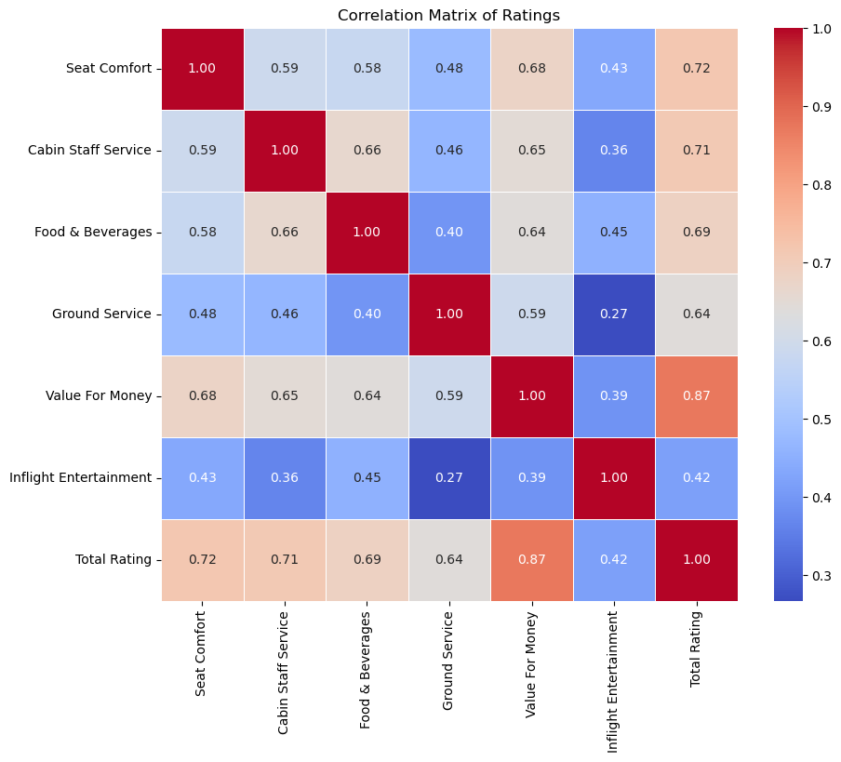
Impact of Various Ratings on Total Rating:
From the Heat map, Value for money is highly corelated to the total ratings which is .84, also seat comfort, cabin staff service, food and beverages are highly related to total rating.

Slide 14
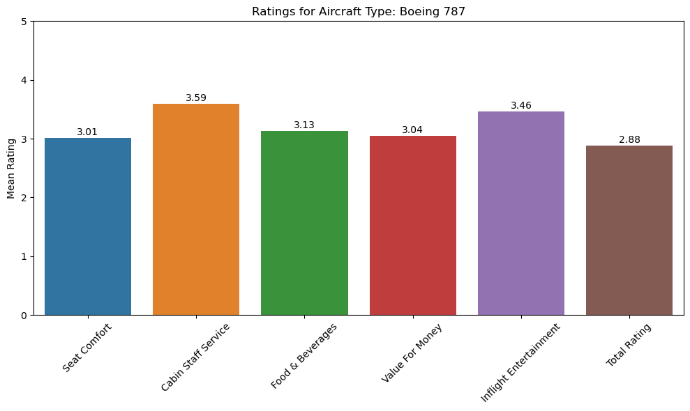
Boeing 787 and its Ratings:
Boeing 787 has the highest average of different ratings, which is more than 3 in every aspects.

Slide 15
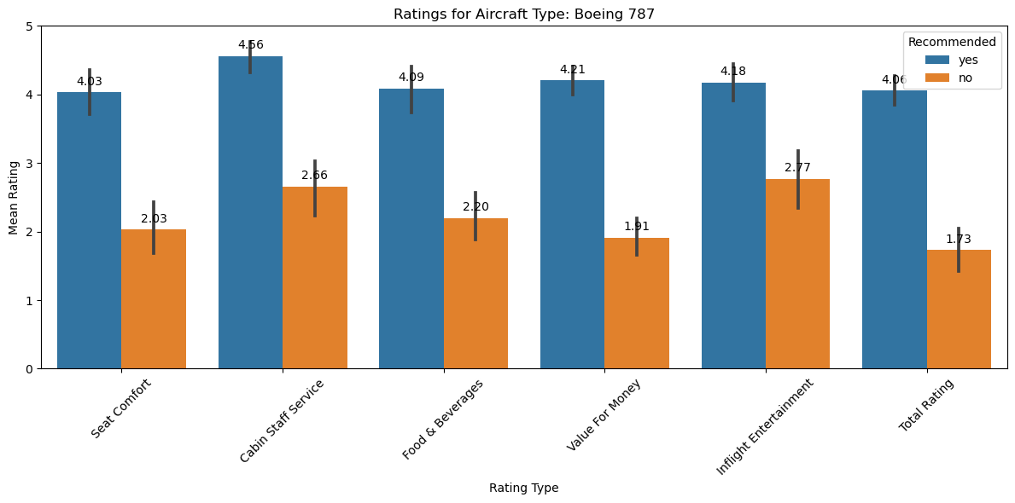
Boeing 787, Ratings and Recommended:

Slide 16
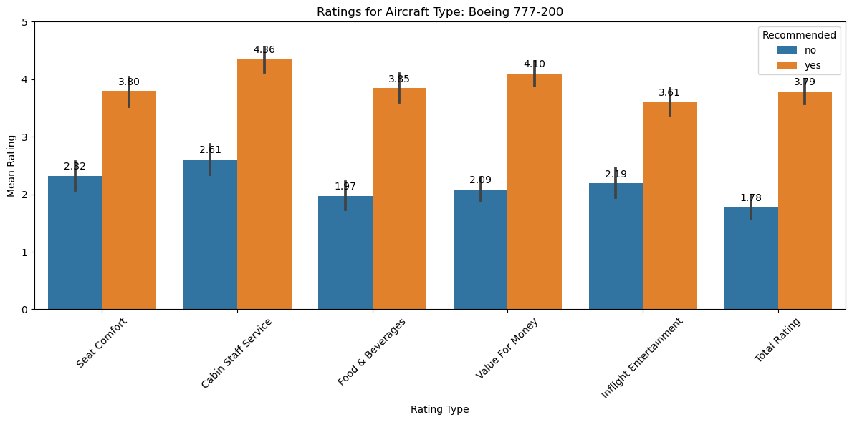
Boeing 777-200, Ratings and Recommended:

Slide 17
Explanation of Various aircrafts, ratings and recommendation:
The most frequent Aircrafts are the A320, Boeing 777, Boeing 747-400, A380, Boeing 777-200, A319, Boeing 747, A321 and Boeing 787 with total of 1491.
Aircrafts Boeing 787, 747-400, 777 and A320 have various average ratings in recommended more than 4.
Aircrafts Boeing 747, 777-300 and A321 have various ratings average in not recommended more than 4

